Slide 1

HAARs cascade vs deep learning model
Justin Bishop

Slide 2
Introduction
The goal of my project will be to blur everyone's faces that is being seen by the camera. I will be comparing two different algorithms against each other. One which is fast but less accurate. The other will be much slower but do a better job.
Algorithm should automatically recognize the face
Algorithm should add confidence counter to show the algorithms own assurance on the blur

Slide 3
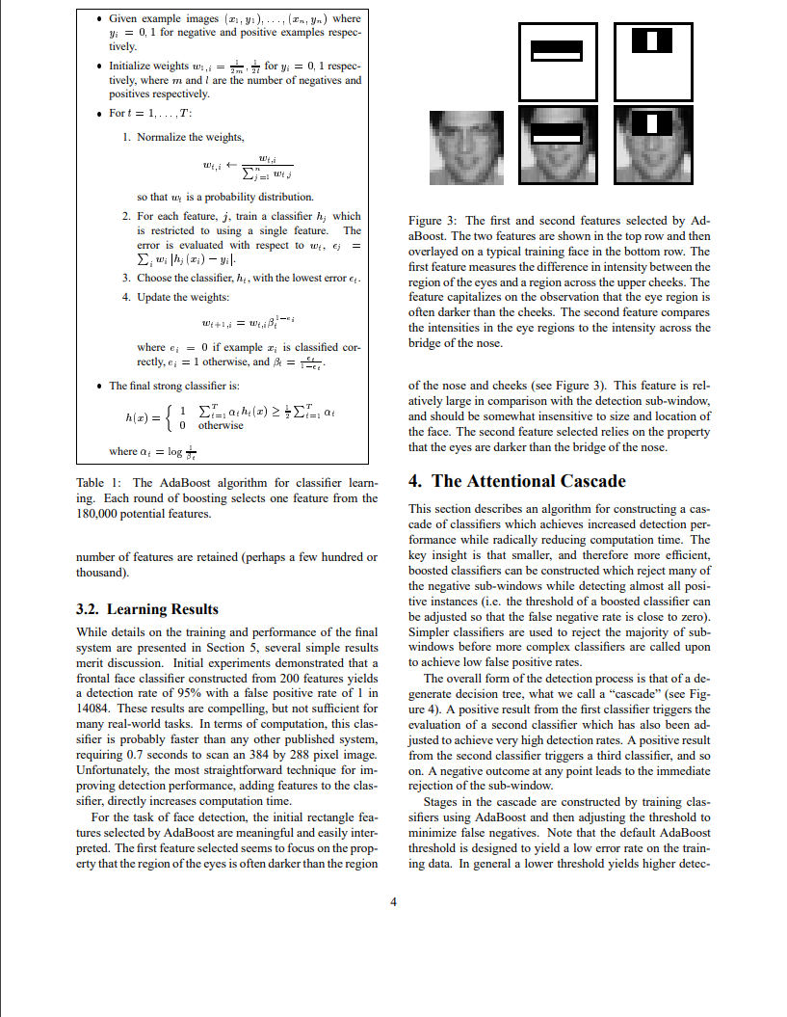
Literature review
Haars Cascade
Focused highly on Viola and Jones paper titled “Rapid Object Detection Using a Boosted Cascade of Simple Features.”
In their paper Viola and Jones describe how their algorithm achieved, “a frontal face detection system which achieves detection and false positive rates which are equivalent to the best published results”.
Machine Learning
Focused on the concept of machine learning
Used examples from paper “Joint Face Detection and Alignment using Multi-task Cascaded Convolutional Networks” by K. Zhang, Z. Zhang, Z. Li and Y. Qiao
- Viola, P., and M. Jones. “Rapid Object Detection Using a Boosted Cascade of Simple Features.” Proceedings of the 2001 IEEE Computer Society Conference on Computer Vision and Pattern Recognition. CVPR 2001, 2001, doi:10.1109/cvpr.2001.990517.

Slide 4
Methodology
HAARSCASCADE
Advantages
Pre trained datasets
Disadvantages
Slower than other methods
Original
Not great at profile of faces
Machine Learning
Advantages
MTCNN model
Very easy to implement
Can detect more of face
Disadvantages
Much slower run time

Slide 5
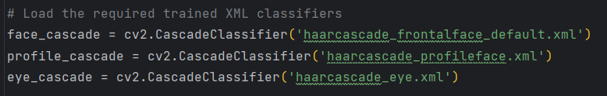
Implementation (HAARs cascade)
Uses pre – built XML classifiers through OpenCV [1]
Frontal Face
Eyes
Profile Face
Gaussian blur
Time to complete
Confidence counter in relation to faces detected

Slide 6
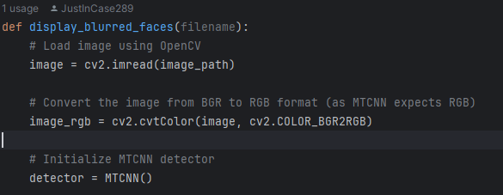
Implementation (Machine learning)
Uses MTCNN model through OpenCV
Time to complete
Gaussian blur
Confidence counter in relation to faces detected

Slide 7
Experimental setup metrics
Accuracy
How many faces were accurately blurred
Time to complete
How long does it take for the algorithm to run and display back image
Confidence
How confident is the algorithm that it correctly identified and blurred a face

Slide 8
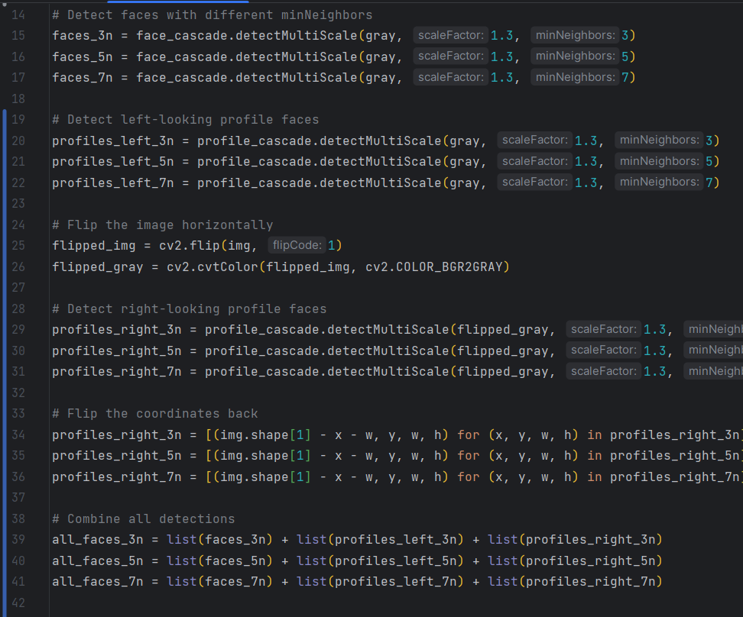
Code snippets (Haars cascade

Slide 9

Code snippets (Haars Cascade)

Slide 10

Code snippets (Machine learning)

Slide 11

Code snippets (Machine learning)

Slide 12

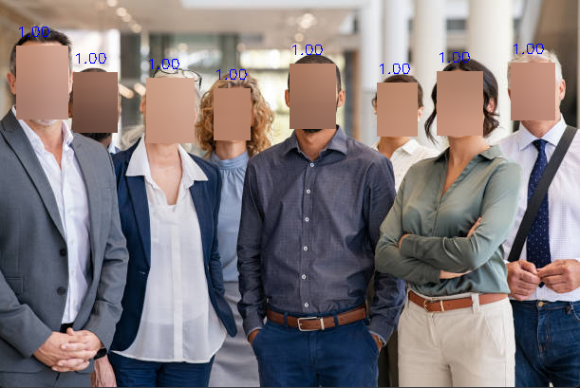
Haars cascade deep learning
IINITAL RESULTS

Slide 13


Haars cascade deep learning
IINITAL RESULTS

Slide 14
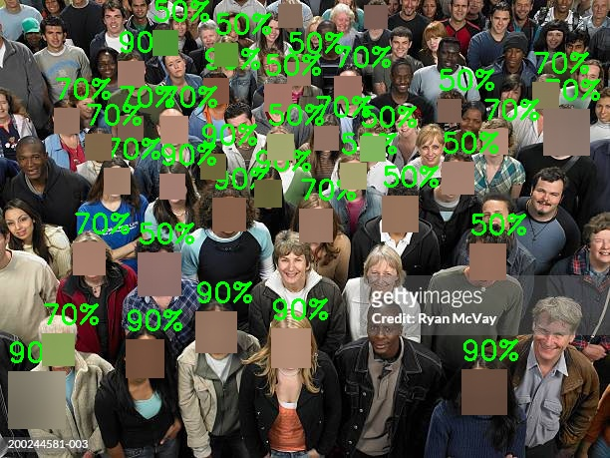
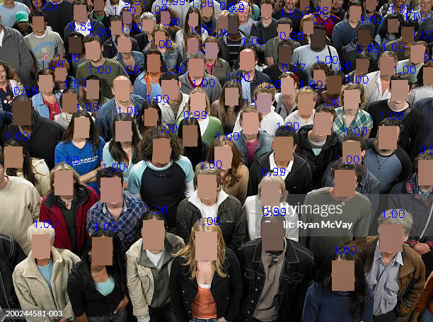
Haars cascade deep learning
IINITAL RESULTS

Slide 15

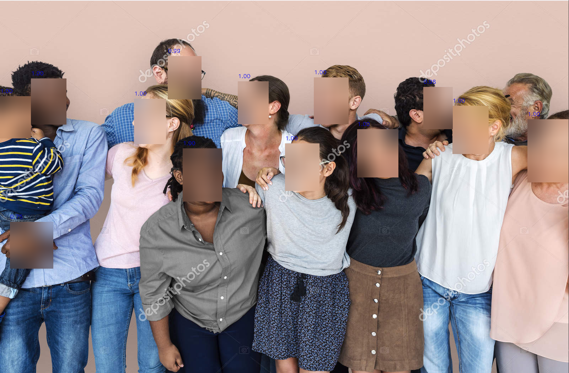
Haars cascade deep learning
IINITAL RESULTS

Slide 16
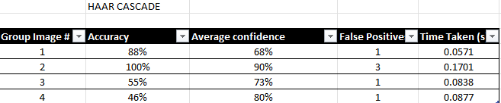
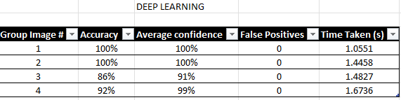
Final results

Slide 17
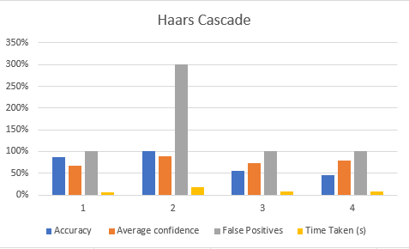
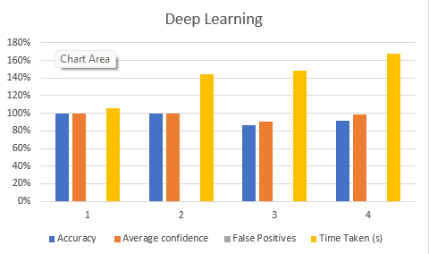
Final results

Slide 18
Conclusion
Results have shown that the machine learning model beats the Haars Cascade model in every single test minus time to complete the task
Machine learning has much more uses such as when the face is not facing the camera directly
Haars Cascade may be faster for real time tracking due to facial detection being overall quicker

Slide 19

References
Ali, Alya’a R., and Ban N. Dhannoon. “Real time multi face blurring on uncontrolled environment based on color space algorithm.” Iraqi Journal of Science, 2019, pp. 618–1626, https://doi.org/10.24996/ijs.2019.60.7.22.
Ali, Alya’a R., and Ban N. Dhannoon. “Real time multi face blurring on uncontrolled environment based on color space algorithm.” Iraqi Journal of Science, 2019, pp. 618–1626, https://doi.org/10.24996/ijs.2019.60.7.22.
A. Sharifara, M. S. Mohd Rahim and Y. Anisi, "A general review of human face detection including a study of neural networks and Haar feature-based cascade classifier in face detection," 2014 International Symposium on Biometrics and Security Technologies (ISBAST), Kuala Lumpur, Malaysia, 2014, pp. 73-78, doi: 10.1109/ISBAST.2014.7013097.
A. Singh; H. Herunde; F. Furtado. "Modified Haar-cascade model for face detection issues". International Journal of Research in Industrial Engineering, 9, 2, 2020, 143-171. doi: 10.22105/riej.2020.226857.1129
“Caltech 10K Web Faces.” Perona Lab - Caltech 10k Web Faces, www.vision.caltech.edu/datasets/caltech_10k_webfaces/. Accessed 20 Oct. 2023.
Devaux, Alexandre. “Face Blurring for Privacy in Street-Level Geoviewers Combining Face ...” ResearchGate, www.researchgate.net/publication/292848049_Face_blurring_for_privacy_in_street- level_geoviewers_combining_face_body_and_skin_detectors. Accessed 18 Sept. 2023.
GitHub, github.com/opencv/opencv/tree/master/data/haarcascades. Accessed 6 Oct. 2023.
Gosper, Maree, et al. Web-Based Lecture Technologies: Blurring the Boundaries between Face-To ..., files.eric.ed.gov/fulltext/EJ809980.pdf. Accessed 18 Sept. 2023.
Howse, Joseph. OpenCV 4 for Secret Agents: Use Opencv 4 in Secret Projects to Classify Cats, Reveal the Unseen, and React to Rogue Drivers. Packt Publishing, 2019.
K. Zhang, Z. Zhang, Z. Li and Y. Qiao, "Joint Face Detection and Alignment Using Multitask Cascaded Convolutional Networks," in IEEE Signal Processing Letters, vol. 23, no. 10, pp. 1499-1503, Oct. 2016, doi: 10.1109/LSP.2016.2603342.
Lewis, Michael B. “Face Detection: Mapping Human Performance - Sage Journals.” SageJournals, journals.sagepub.com/doi/10.1068/p5007. Accessed 18 Sept. 2023.
Meenakshi, M. “Real-time facial recognition system—design, implementation and validation.” Journal of Signal Processing Theory and Applications, 10 Nov. 2012, https://doi.org/10.7726/jspta.2013.1001.
Opencv. “Opencv/Opencv: Open Source Computer Vision Library.” GitHub, github.com/opencv/opencv. Accessed 19 Oct. 2023.
R. Padilla, et al. Evaluation of Haar Cascade Classifiers Designed for Face Detection. 2910, Zenodo, Apr. 2012, doi:10.5281/zenodo.1058133.
Viola, P., and M. Jones. “Rapid Object Detection Using a Boosted Cascade of Simple Features.” Proceedings of the 2001 IEEE Computer Society Conference on Computer Vision and Pattern Recognition. CVPR 2001, 2001, doi:10.1109/cvpr.2001.990517.

